Slide 1



What’s Cooking with PowerShell Core?
Thursday - 04/12/2018
PowerShell + DevOps Global Summit 2018

Slide 2





Maximo Trinidad
Technology Evangelist
Microsoft MVP - Cloud and Datacenter Management (PowerShell)
MVP Link: https://mvp.microsoft.com/en-us/PublicProfile/4024451?fullName=Maximo%20%20Trinidad
SAPIEN Technologies MVP 2017: https://www.sapien.com/blog/2016/12/21/sapien-mvp-2017-award-winners/
IDERA ACE member 2017: http://community.idera.com/blog/b/community_blog/posts/meet-your-2017-idera-aces
Blog: http://www.maxtblog.com/
Email: maxt@sapien.com
Twitter: @maxtrinidad
Twitter: @SapienTech

Slide 3
Desktop Cross-Platform Environment
Windows 10 Build 16299
Windows Subsystem for Linux
Editors At Play
Lightweight Editors
Enterprise Editors
Desktop Goodies
Languages and other tools
PowerShell Core
Python
SQL Server
OpenSSH
Windows PowerShell vs PowerShell Core
Name Differences
Supported Platforms Differences
Reporting Feedbacks and Issues
PowerShell Current Status
Agenda

Slide 4
Desktop Cross-Platform Environment
Windows 10 Build 16299
Windows Subsystem for Linux:
Available from the Microsoft Store
Install from the “Turn Windows features on or off” option
Windows Subsystem for Linux
Ubuntu
SUSE
Cloud Solution
Hyper-V
VMWare
Virtual Box
Create Virtual Machine(s):
Install available Linux distro:
Azure
Amazon (not covered)

Slide 5
Desktop Editors At Play
Lightweight Editors:
Windows ISE
Visual Studio Code (xplat)
VIM/Emacs24.. (xplat)
Enterprise-Level Editors:
Visual Studio
SAPIEN PowerShell Studio 2018
SAPIEN Product Suite.
Others

Slide 6
Few of the main features:
Templates Wizards
Script File Grouping
Custom Tools
Cache Editor
Object Browser
Script Debugging
Option – *New* Console setup
Extending use of Windows Console (*PSCore6)

Slide 7
Desktop
Languages and other tools
PowerShell Core
Anaconda (Python 3.6)
SQL Server
OpenSSH
Linux WinRm (Complex setup)

Slide 8
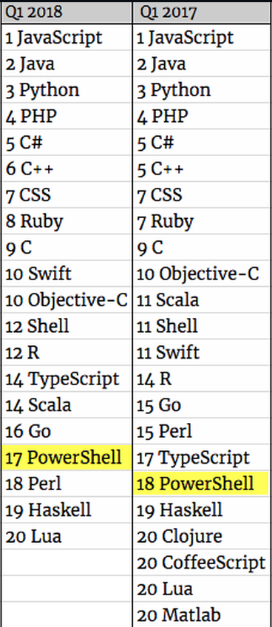
Top Demand Programming Languages

Slide 9
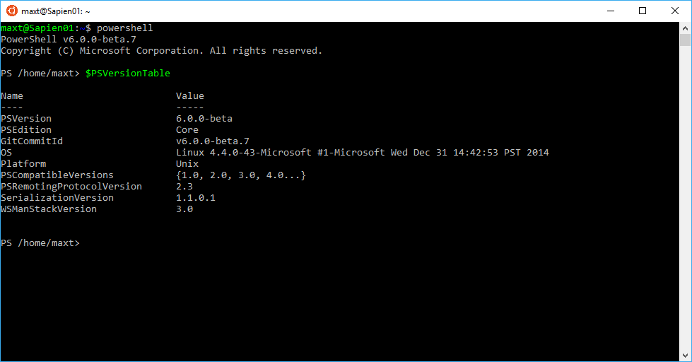
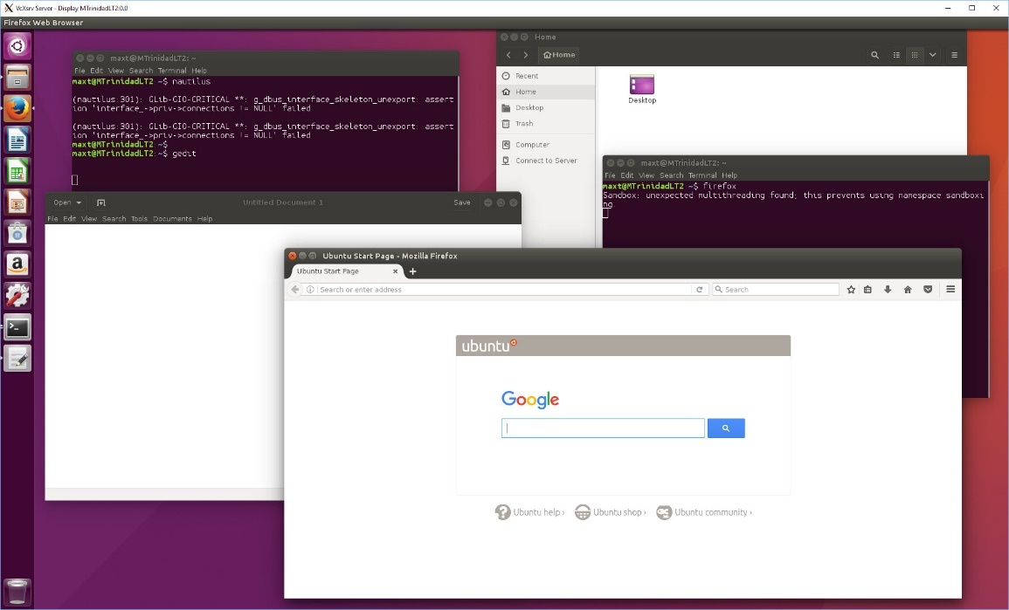
Windows 10 Build 16299 – WSL Ubuntu
6

Slide 10
Windows PowerShell vs. PowerShell Core
Name Differences
Windows PowerShell – Microsoft Trademark
PowerShell Core – Open Source
Supported Platforms Differences
Windows PowerShell – Only Windows OS’s
PowerShell Core – Windows, Linux Distro, and Mac OS
Reporting Feedbacks and Issues
Windows PowerShell – Report using UserVoice forum
PowerShell Core – Report using *Github issues
PowerShell Status
Windows PowerShell is Complete
PowerShell Core is next generation
Will not replace Windows PowerShell
All efforts directed towards PowerShell Core
*Note: Reporting Windows PowerShell issues are not handle in Github and it won’t be neither moved to UserVoice forum.

Slide 11
PowerShell Core Installation
Github - Well Documented and Easy to follow
Check/Read PowerShell Core landing page: https://github.com/PowerShell/PowerShell
Check Platforms installations: https://github.com/PowerShell/PowerShell#get-powershell
Then, follow instructions

Slide 12
Working with PowerShell Gallery and Nuget
Windows PowerShell - PSGallery Modules
C:\Program Files\WindowsPowerShell\Modules
PowerShell Core - PSGallery modules
C:\Program Files\PowerShell\Modules
PowerShell Core - Only PSCore modules
C:\Program Files\PowerShell\6.x.x-preview.x\Modules
Nuget Packages: (Both Posh)
C:\Program Files\PackageManagement\NuGet\Packages

Slide 13
Windows PowerShell Specialized Packages
Chocolatey Packages Management
Install Chocolatey module from web: https://chocolatey.org/install
Chocolatey Specialized Packages
Install VcxSrv - Windows X Server for WSL
For information type:
Install OpenSSH - Win32 OpenSSH (Universal Installer)
For information type:
“choco install VcxSrv”
“choco install OpenSSH”

Slide 14
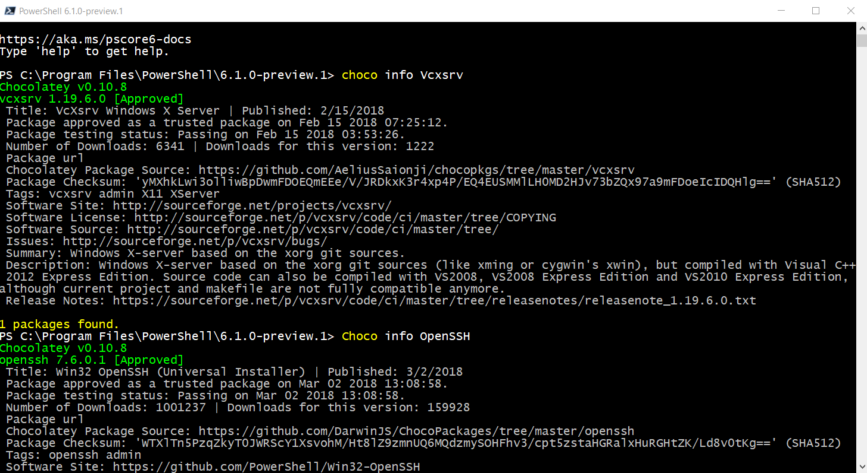
Chocolatey Packages Information

Slide 15
Nuget Package Management
Install .NET Developed Packages
.NET Framework – Windows Full CLR (Common Language Runtime) Apps/Web Development
.NET Core – Not Full CLR (Common Language Runtime)
Windows (no Windows Form Support)
Linux
Mac OS
.NET Core Package Example
To check Nuget Package(s) use
Both Windows, and Linux cross-platform
Example to get SMO DLL’s to manage SQL Server(s)
Find-Package cmdlet
Install-Package cmdlet
Find-Package –name Microsoft.SqlServer.SqlManagementObjects

Slide 16





Cross-Platform Eco System
Admin/DevOps
On-Premise
Cloud
Hybrid

Slide 17
Demo
Working with your Desktop Tools

Slide 18
Resources
Check out Jeffrey Snover video. In this video he mention that security has improve greatly and many other interesting thing about PowerShell: https://www.youtube.com/watch?v=myQkHM_je70#action=share
PowerShell Core 6.0: Generally Available (GA) and Supported: https://blogs.msdn.microsoft.com/powershell/2018/01/10/powershell-core-6-0-generally-available-ga-and-supported/
PowerShell Core 6.1 Roadmap: https://blogs.msdn.microsoft.com/powershell/2018/01/24/powershell-core-6-1-roadmap/
PowerShell Core Open Source: https://github.com/PowerShell/PowerShell
Windows PowerShell bugs reported in UserVoice: https://windowsserver.uservoice.com/forums/301869-powershell
Windows 10 Bash and PowerShell Redux: http://www.maxtblog.com/2017/01/windows-10-bash-and-powershell-redux/
MonadManifesto: http://www.jsnover.com/Docs/MonadManifesto.pdf

Slide 19
Resources…
13
Python SQL Server ODBC connector (pyodbc): https://github.com/mkleehammer/pyodbc
Bash for Windows 10: https://blogs.msdn.microsoft.com/commandline/learn-about-bash-on-windows-subsystem-for-linux/
https://blogs.msdn.microsoft.com/commandline/2016/11/17/do-not-change-linux-files-using-windows-apps-and-tools/
What is Anaconda: https://www.anaconda.com/what-is-anaconda/
Python 3.6 Anaconda in SQL Server 2017: https://blogs.technet.microsoft.com/dataplatforminsider/2017/04/19/python-in-sql-server-2017-enhanced-in-database-machine-learning/
PowerShell, and SQL Server Working with Anaconda
http://www.maxtblog.com/2017/05/powershell-and-sql-server-working-with-anaconda/
Microsoft blog - MVP Award program Blog:
https://blogs.msdn.microsoft.com/mvpawardprogram/2017/05/26/friday-five-may-26th/?wt.mc_id=DX_883076
https://blogs.msdn.microsoft.com/mvpawardprogram/2017/03/10/friday-five-march-10th/
https://blogs.msdn.microsoft.com/mvpawardprogram/2017/02/17/friday-five-feb-17th/
https://blogs.msdn.microsoft.com/mvpawardprogram/2016/12/23/friday-five-dec-23/
MSSQLTips
Unable to communicate with the runtime for 'R' script in SQL Server (applies to Python)
https://www.mssqltips.com/sqlservertip/4557/unable-to-communicate-with-the-runtime-for-r-script-in-sql-server/

Slide 20
GiveAway

Slide 21

Contact information:
Maximo Trinidad
Technology Evangelist
Email: maxt@sapien.com
SAPIEN Technologies MVP 2017
Microsoft MVP - Cloud and Datacenter Management
IDERA ACE member 2017
Blog: http://www.maxtblog.com/
Blog: http://www.sapien.com/blog
Twitter: @maxtrinidad
Twitter: @SapienTech

